Slide 1
Infosys_ElectViz
Election Data Visualization for media
Mentor :
Mrs. Nithyasri S J
By:
B. Nandhini

Slide 2
Introduction
Elections generate large, complex datasets involving candidates, parties, voters and constituencies.
Manual analysis of election data is time-consuming and error-prone.
ElectViz is an interactive Power BI dashboard designed to:
  Analyze Indian election data across multiple years
  Identify party performance, voter behavior and winning patterns
  Support data-driven insights for political analysis
Objective:
To transform raw election data into clear, interactive and meaningful visual insights.

Slide 3
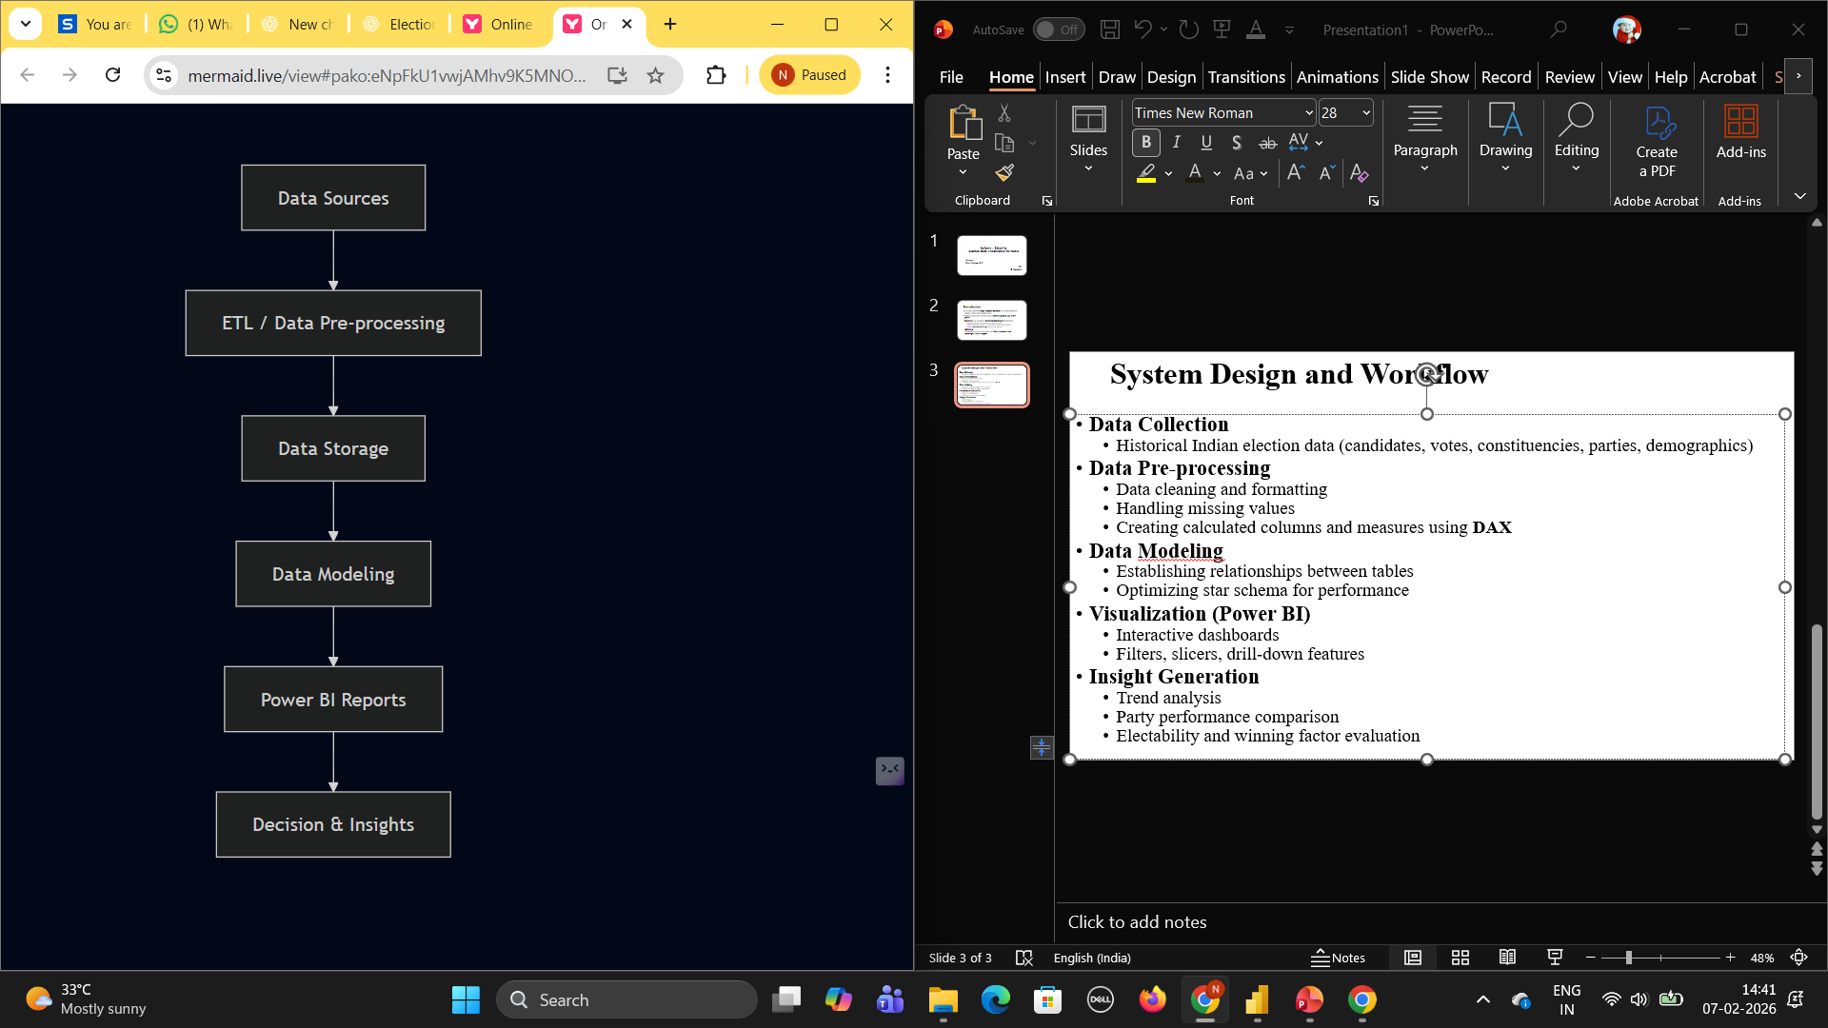
System Design and Workflow
Data Collection
  Historical Indian election data (candidates, votes, constituencies, parties, demographics)
Data Pre-processing
  Data cleaning and formatting
  Handling missing values
  Creating calculated columns and measures using DAX
Data Modelling
  Establishing relationships between tables
  Optimizing star schema for performance
Visualization (Power BI)
  Interactive dashboards
  Filters, slicers, drill-down features
Insight Generation
  Trend analysis
  Party performance comparison
  Electability and winning factor evaluation

Slide 4
Dashboard Overview
ElectViz consists of 7 analytical pages:
Election Overview
Party Performance Analysis
Gender Distribution Analysis
Candidate Demographic Analysis
Electability Analysis
Trend Analysis
Election Outcome & Winning Factor Analysis
Each page focuses on a specific analytical objective.

Slide 5
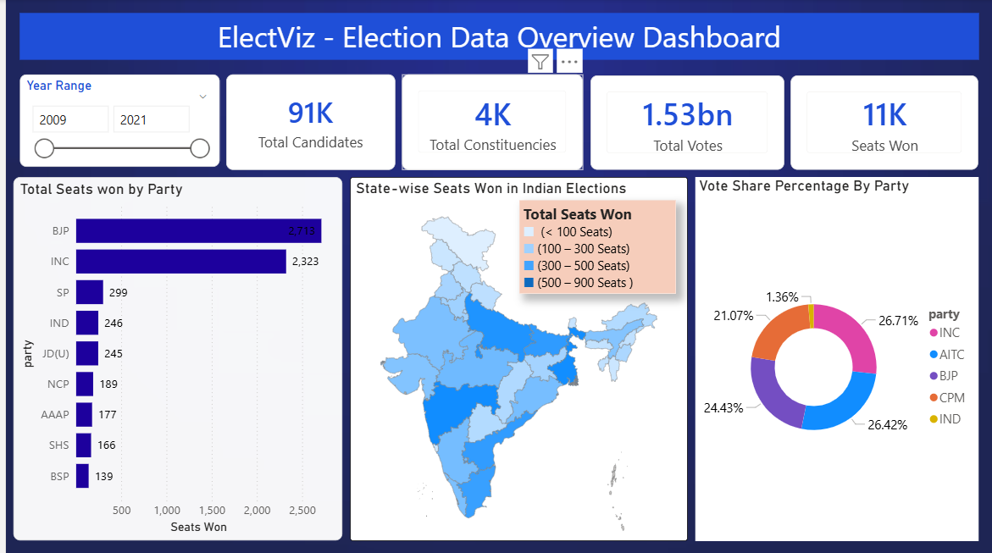
Screenshots
1. Election Data Overview Dashboard
Key Insights Displayed:
Total Candidates, Constituencies, Votes, Seats Won
Party-wise seats won comparison
State-wise seats won using map visualization
Vote share percentage by party
Purpose:
Provides a high-level summary of election outcomes at national and state levels.

Slide 6
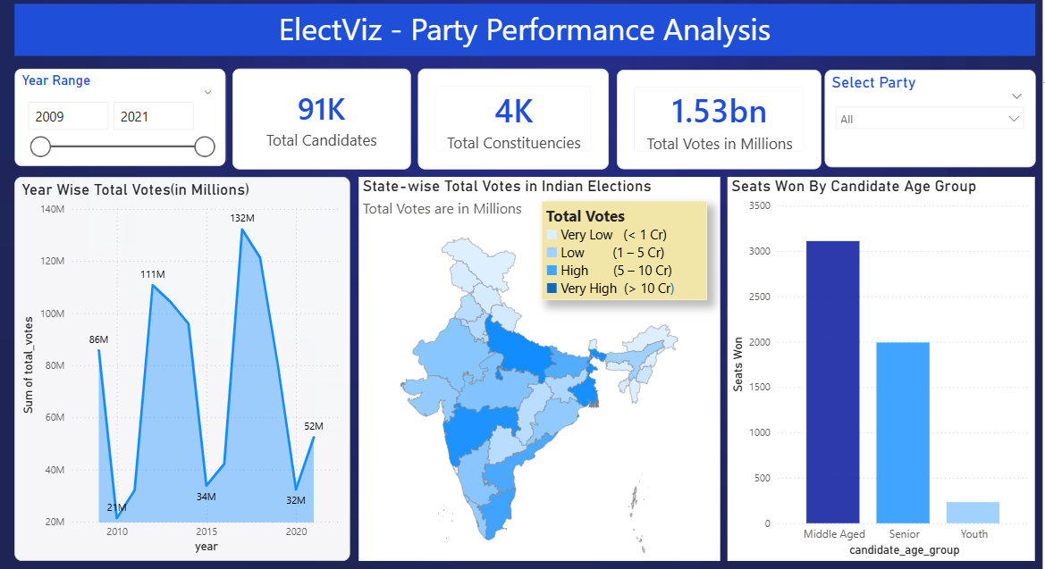
2. Party Performance Analysis
Key Insights:
Year-wise total votes trend
State-wise vote distribution
Seats won by candidate age group
Party filter for focused analysis
Purpose:
Helps compare party dominance, growth trends, and age-based success.

Slide 7
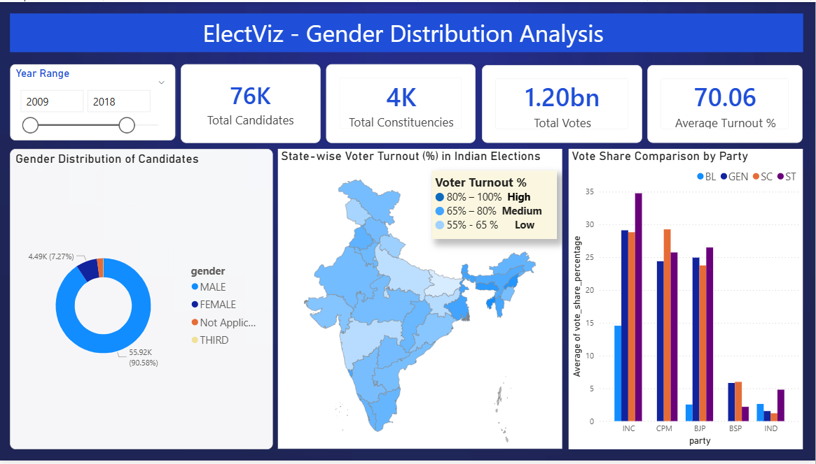
3. Gender Distribution Analysis
Key Insights:
Gender distribution of candidates
State-wise voter turnout percentage
Vote share comparison by gender and category
(GEN, SC, ST)
Purpose:
Analyzes gender participation and inclusivity in elections.

Slide 8
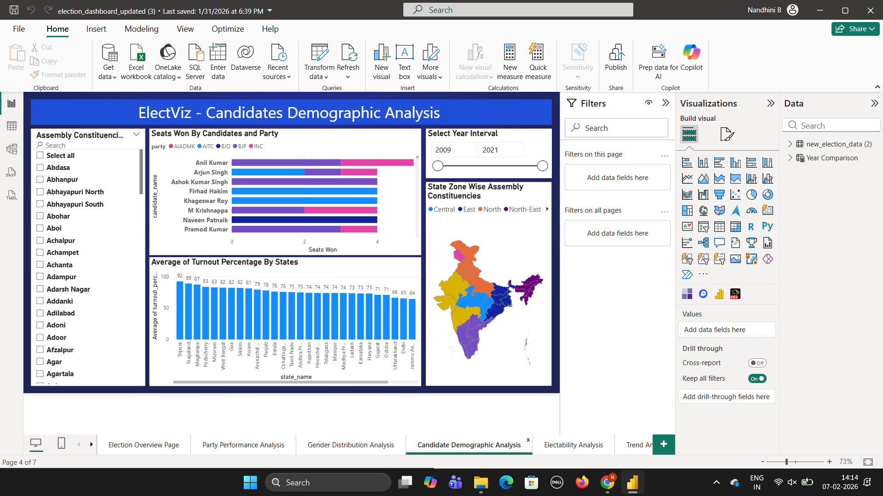
4. Candidate Demographic Analysis
Key Insights:
Seats won by candidates and parties
Constituency-level filtering
State zone-wise assembly constituencies
Average voter turnout by state
Purpose:
Examines candidate-level performance and regional participation patterns.

Slide 9
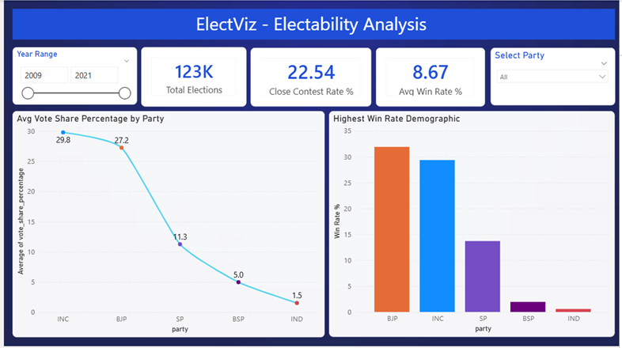
5. Electability Analysis
Key Insights:
Close contest rate
Average win rate
Average vote share by party
Highest win-rate demographic groups
Purpose:
Identifies winnability patterns and competitive intensity in elections.

Slide 10
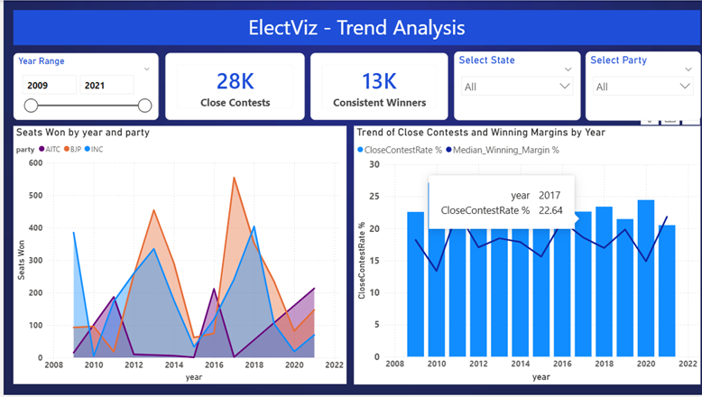
6. Trend Analysis
Key Insights:
Seats won by party over time
Trend of close contests
Winning margin variations year-wise
State and party filters
Purpose:
Helps understand long-term political trends and shifts in voter behavior.

Slide 11
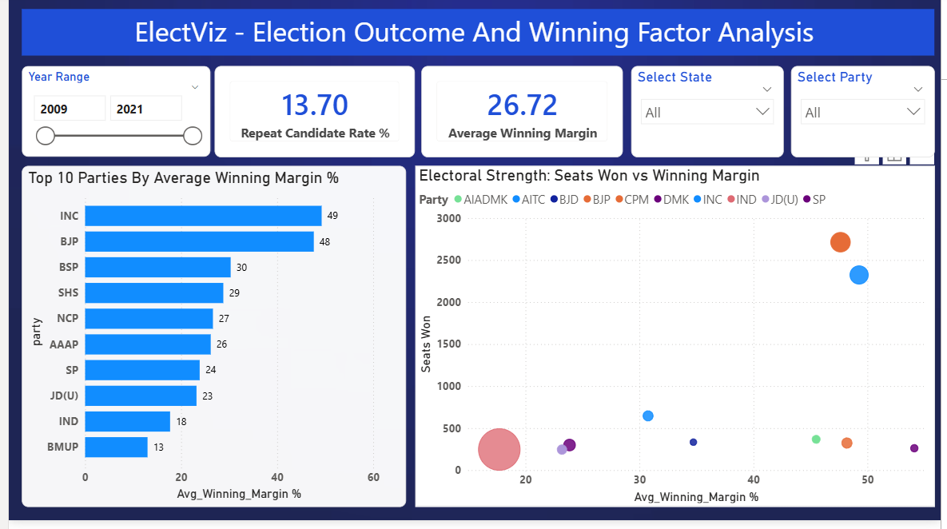
7. Election Outcome & Winning Factor Analysis
Key Insights:
Repeat candidate success rate
Average winning margin
Top parties by winning margin
Electoral strength comparison using scatter plot
Purpose:
Identifies key factors influencing election outcomes.

Slide 12
Future Enhancements
Integration of real-time election data
Advanced predictive analytics using ML
Sentiment analysis using social media data
Constituency-level forecasting
Web-based deployment for public access

Slide 13
Conclusion
ElectViz successfully converts raw election data into actionable insights
Enables:
Better understanding of political performance
Identification of voter and candidate trends
Data-driven decision making
The dashboard is interactive, scalable and insightful
Can be extended for future elections and predictive analysis

Slide 14
Thank You!

